Slide 1


PANIMALAR ENGINEERING COLLEGE
DEPARTMENT OF COMPUTER SCIENCE AND ENGINEERING
CS8811 PROJECT WORK
Title of the Project:
Image to Audio conversion for blind people
BY
Guide Name: ms. C.vijayalakshmi
211418104194- Pradeep k
211418104152-Sai Kasi Viswanath M
BATCH NO: D-14
211418104128-Kodigala Sri Abhilash

Slide 2
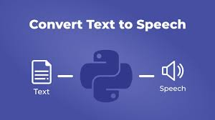
Abstract of the project
People who are blind or have impaired vision are known to have a slew of other having issues like Reading
Optical Character Recognition devices are
available for visually challenged people who
want to read a text.
These devices allow them to analyze the
content line at a time and convert it to braille
. This isn't really practical.
There is a need for an application to assist visually impaired persons and the elderly in detecting text, identifying text, and reading other written material with the use of audio.
As a result, we create a system that assists visually challenged persons in scanning an image and converting the identified text into a spoken message.
​

Slide 3

Objectives
The main objective of the project is to design an application that helps the visually impaired people to scan the image and convert the detected text in to voice message.
It presents a methodology for text
recognition by converting it into
audio format for people who suffer
with loss of vision.
The proposed method enables the visually impaired people to see with the help of ears.
Natural Language Processing is used to support the system proposed.

Slide 4

Existing System and It's Draw backs
Many systems have been developed for the image to audio conversion for
blind people to get maximum results and achieve state-of-the-art accuracy for the given problem.
The existing methods based on have achieved
remarkable results for the text to audio, but it is still
difficult to obtain speech with higher accuracy.
It can only convert the text inputs of the image into
words and thus, isn’t very efficient to be used in
real-world applications for helping blind people.
In the existing model, CNN is used which is computationally expensive.
They require a huge training data set, and Its preprocessing time is quite high .
​

Slide 5

Proposed System and It's Advantages
We propose a model for the image to audio conversion for blind people
using machine learning techniques.
Input will be given in the form of an image, which
will be processed so that the texts in the image would
get converted to audio, to be received as the output
of the system.
The proposed system has shown excellent
Performance with a high accuracy rate and a
much higher speed up rate as compared to the previously used state-of-the-art methods.
It is independent of the user's physical interaction. It has very precise
measurements and permits for high deployment and authentication.
Use of our framework is not limited to a single field of application and is
useful for many more real-world applications.

Slide 6
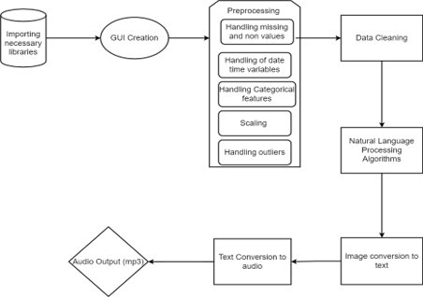
SYSTEM FLOW ARCHITECTURE
​

Slide 7
MODULE SPLIT UP
IMPORT OF BASIC LIBRARIES AND CREATING GUI​
CONVERSION OF IMAGE TO TEXT​
CONVERSION OF TEXT TO AUDIO (mp3)​

Slide 8
Import of Basic Libraries And Creating GUI
METHODOLOGY
The first step is data collection where libraries are imported from source websites.
The dataset is of high quality images with high resolution for better accuracy and precision.
We use Natural Language Processing in the proposed system for better performance and accuracy.
The complete system is built using GUI with higher accuracy.
ALGORITHM – Natural Language Processing
OUTPUT OF THE MODULE We obtain high quality images in the .PNG format which will be processed to be converted into text accurately and efficiently.

Slide 9
Conversion of Image To Text
METHODOLOGY
Noise removal is done using a bilateral filter. This enables us to detect and extract only that region that contains text and removes the unwanted background.
Then the text is forwarded to a second algorithm in charge of correcting the text and recovering sentences when possible. Finally, the result is converted to text using the Text-to-Speech algorithm
This is done to allow the OCR to efficiently convert the image to text.
ALGORITHM – Raspberry Pi
OUTPUT OF THE MODULE
It converts the pre-processed image, which is in .png form, to a .txt file.

Slide 10
Conversion of Text To Audio(MP3)
METHODOLOGY
The final module is the voice processing module. It converts the .txt file to an audio output.
The speech synthesizer converts the final content into audio output to the visually impaired user. This system produces human speech artificially.
The module performs the task of conversion of the transformed text to the audible form. It can be implemented in either hardware or software form.
ALGORITHM - AdaBoost Algorithm
OUTPUT OF THE MODULE
The text is extracted and converted into an audio output in the mp3 format.

Slide 11
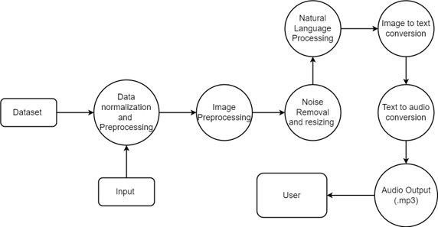
Implementing The Usecase

Slide 12
Algorithm/ Technique Used
Here we use Adaboost
It combines multiple classifiers to increase the accuracy of classifiers. AdaBoost is an iterative ensemble method.
The basic concept behind Adaboost is to set the weights of classifiers and train the data sample in each iteration such that it ensures accurate predictions of unusual observations.
Any machine learning algorithm can be used as a base classifier if it accepts weights on the training set.
It assigns the weight to the trained classifier in each iteration according to the accuracy of the classifier.
The more accurate classifier will get high weight.This process iterate until the complete training data fits without any error or until reached to the specified maximum number of estimators.
To classify, perform a "vote" across all of the learning algorithms you built.

Slide 13
Algorithm/ Technique Used
Here we used Natural Language Processing
Natural Language Processing, or NLP for short, is broadly defined as the automatic manipulation of natural language, like speech and text, by software.
Step 1: Sentence Segmentation: Breaking the piece of text in various sentences.
Step 2: Word Tokenization: Breaking the sentence into individual words known as tokens
Step 3: Predicting Parts of Speech for each token: Predicting whether the word is a noun, verb, adjective, adverb, pronoun, etc.
Step 4: Identifying stop words
Step 5: Dependency Parsing: This means finding out the relationship between the words in the sentence and how they are related to each other.
Step 6: Named Entity Recognition(NER): Kinds of objects that a typical NER system can tag: People’s names. Company names. Geographical locations Product names. Date and time. Amount of money.

Slide 14
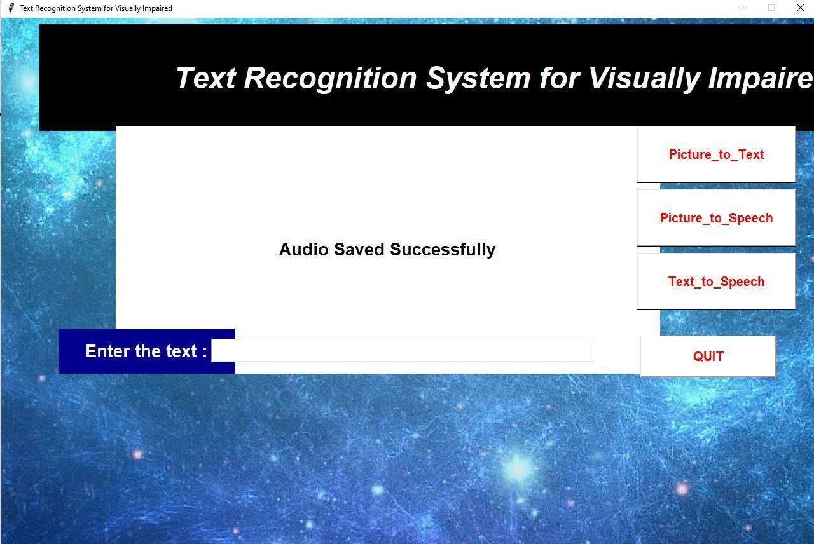
Sample Output

Slide 15
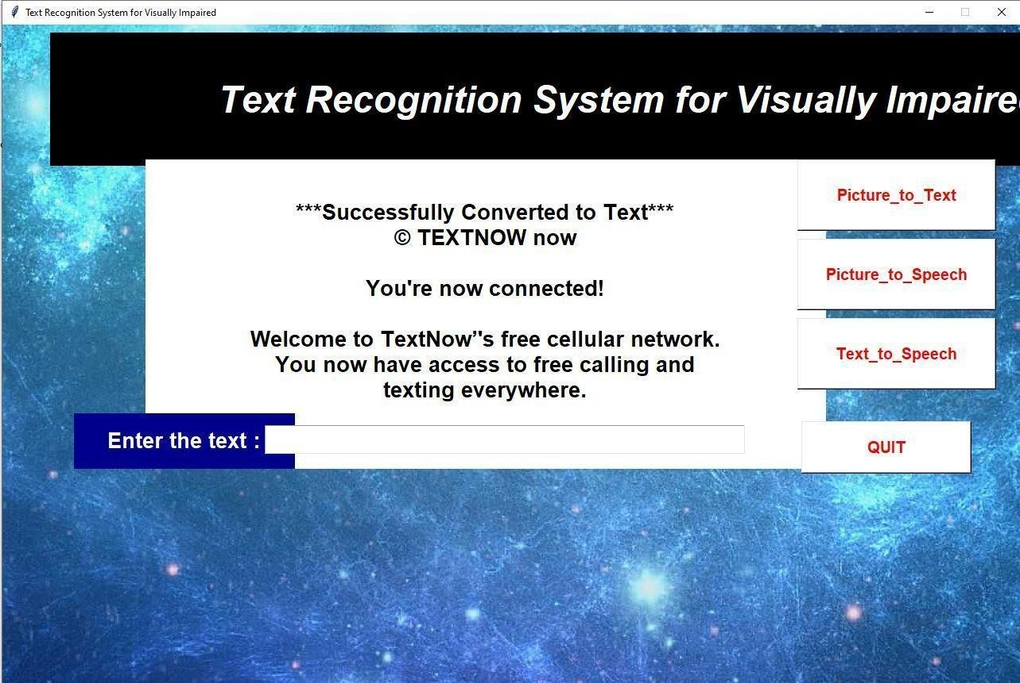
Sample Output

Slide 16
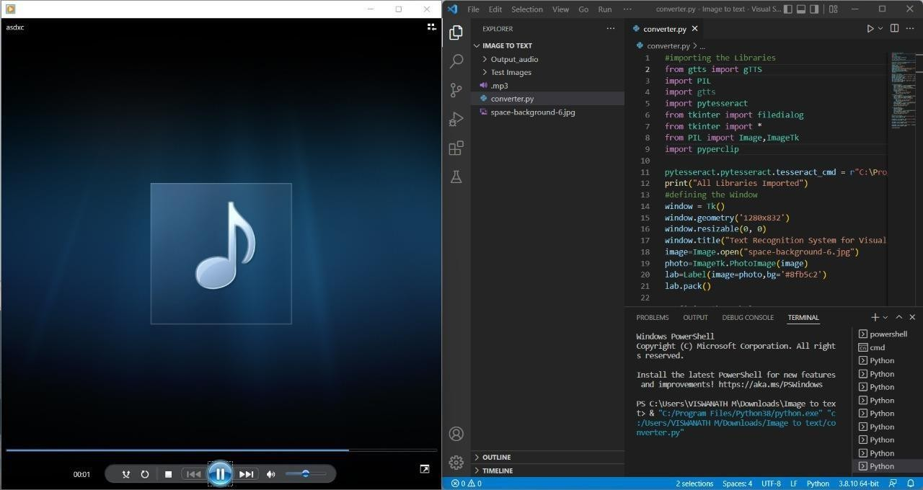
Sample Output

Slide 17
References
K. C. SHAHIRA, “Towards Assisting the Visually Impaired: A Review on Techniques for Decoding the Visual Data From Chart Images,” IEEE Access,
Volume 9, 2021
Sai Aishwarya Edupuganti; Vijaya Durga Koganti; Cheekati Sri Lakshmi; Ravuri Naveen Kumar, “Text and Speech Recognition for Visually Impaired People using Google Vision,” 2021 2nd International Conference on Smart Electronics and Communication (ICOSEC), 2021
Prabhakar Manage; Veeresh Ambe; Prayag Gokhale; Vaishnavi Patil, “An Intelligent Text Reader based on Python,” 2020 3rd International Conference on Intelligent Sustainable Systems (ICISS), 2020
Asha G. Hagargund, Sharsha Vanria Thota, Mitadru Bera, Eram Fatima Shaik “Image to speech conversion for visually impaired,” International Research Journal of Engineering and Technology (IRJET), Volume 03, Issue, 2017

Slide 18
END

